Slide 1
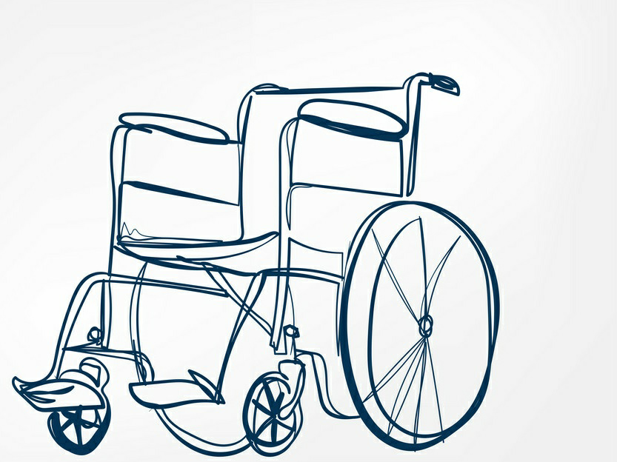
SMART WHEELCHAIR
Presented by;

Slide 2
ABSTRACT:
Smart Wheel Chair is mechanically controlled devices designed to have self mobility with the help of the user command. This reduces the user’s human effort and force to drive the wheels for wheelchair. Furthermore it also provides an opportunity for visually or physically impaired persons to move from one place to another.

Slide 3
INTRODUCTION:
This is a simple prototype of Smart Wheelchair.
The wheelchair is multi functioned.
One can use this wheelchair for various purposes.
This chair can be used as panic alarm.
If the person needs instant help, he/she can hit the panic alarm button so that someone can help him/her immediately.
This wheelchair also has a led light.
So, anyone can roam here and there when the surroundings has not enough light.
Last but not the least this wheelchair is also automatically identify the obstacles and it makes decision to go with the obstacle free path.

Slide 4
OBJECTIVE:
The objective of this project is to help physically challenged people.
It will basically very helpful for those who cannot able to walk.
Physically challenged people can use this android based wheel chair.
It uses android based Smartphone’s which have inbuilt axis accelerator sensors and Bluetooth wireless technology

Slide 5
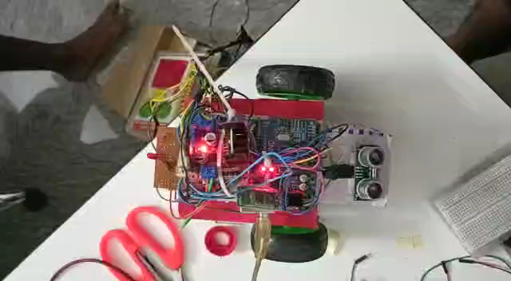
WORKING MODEL
OUR WORKING FINAL GIF HERE

Slide 6
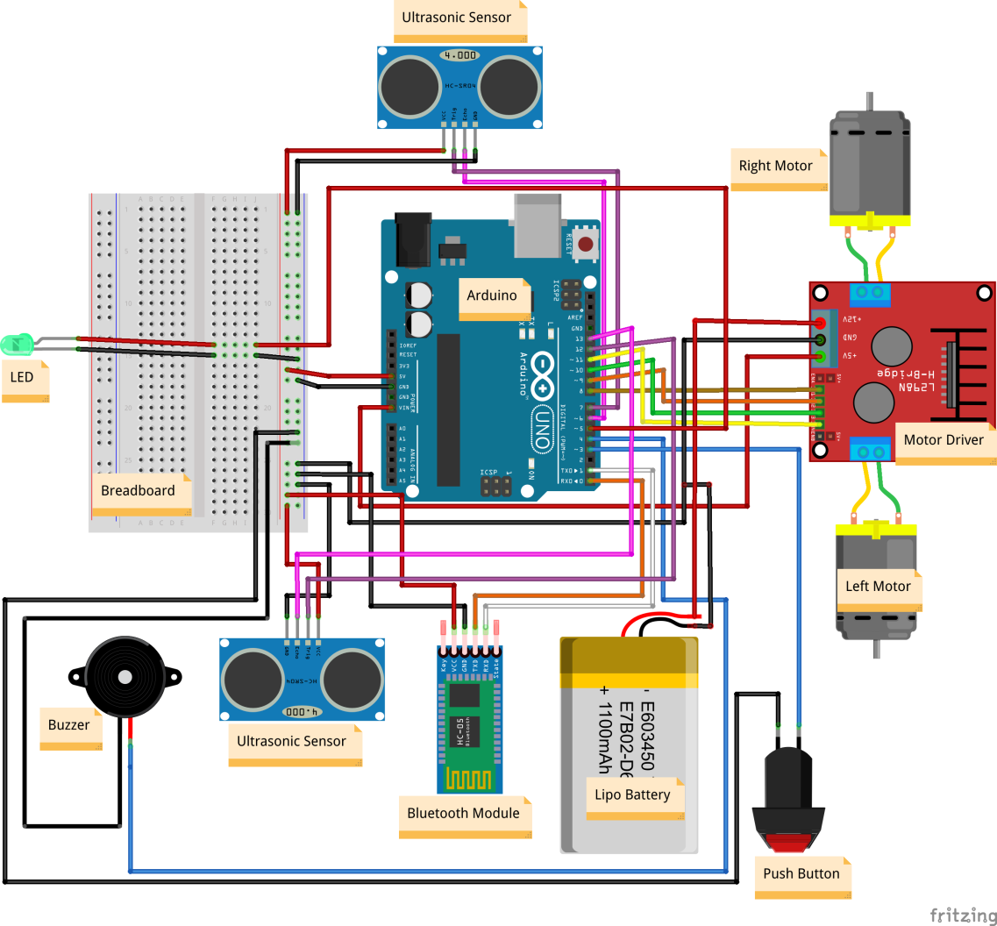
Circuit Diagram:

Slide 7
ADVANTAGES :
• Obstacle detection using IR sensor.
• Less expensive than the conventional wheel
chair.
•Smart wheelchairs have been designed that
provide navigation assistance to the user in
a number of different ways, such as assuring
collision-free travel, aiding the
performance of specific tasks (e.g., passing
through doorways) and autonomously
transporting the user between locations.

Slide 8
APPLICATIONS :
Physically Challenged People :
Physically Disabled People can use it as per their purposes.
Patients in the Hospitals :
People suffering from certain paralysis can use either voice or head movement as per requirement
Old Age Homes :
People at old age homes can use this chair as per their requirement.

Slide 9
FUTURE SCOPE:
Improvements can be made by using various hand gestures of the user.
Battery can be recharged by alternator.
Automatic balancing of sitting area can be provided using secondary accelerometer in case of bumps and curbs.
Eyes movement based automated wheel chair.
Navigating the actual position of wheel chair.

Slide 10
CONCLUSION:
The main aim of this project implementation is to help all the people who are dependent on wheelchair for their mobility.
Wheelchair is simple to operate and does not need any external help.
The objectives of this project have been achieved successfully.
This project was able to develop an android system that can control the movement of the wheelchair.
The application built can be useful for many android phones.

Slide 11
THANK YOU

